Slide 1


ACHIEVING RESILIENCY IN WATER AND WASTEWATER UTILITIES IN THE DANUBE REGION
2019 Danube Water Conference

Slide 2
2019 Danube Water Conference
Discuss the needs to achieve resilient water and sanitation services in the Danube region
195+ Participants from national and local governments, regulatory agencies, water utilities and professional associations in 25+ countries
Organized by IAWD and the World Bank under the Danube Water Program with funding from Austrian Government
Institutional supporter
Notes:
David

Slide 3

Further conference supporters
Premium supporter
Conference supporters
Notes:
Mention stands in the back
Opportunity to network in breaks as well as at business reception

Slide 4
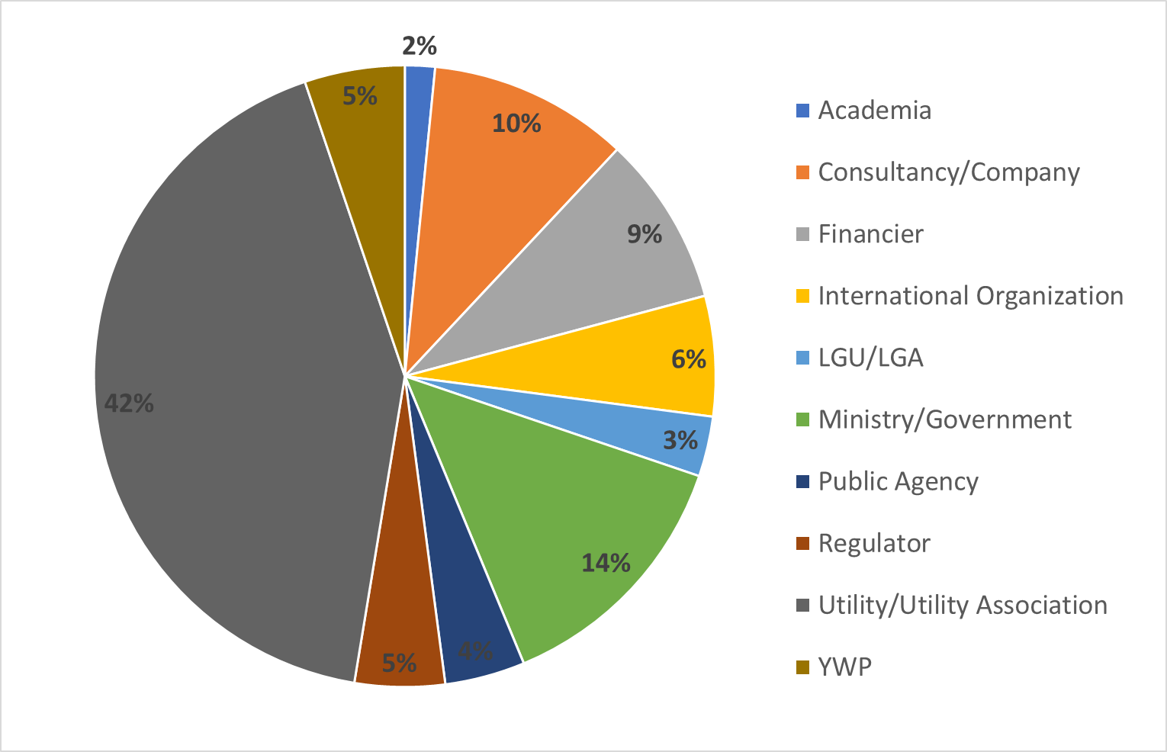
2019 DWC Participants

Slide 5
The state of the sector
Countries now face the triple challenge of achieving sustainable services and EU acquis harmonization in the context of changing climate, decreasing populations, disruptive technology and economies with uncertain prospects.

Slide 6
The third phase of DWP
Focus on flagship activities that have been developed:
  development and update of key regional analytical and advisory activities
  DANUBIS.org and benchmarking activities
  Danube Learning Partnership
  Danube Water Conference
NEW: Water Security

Slide 7
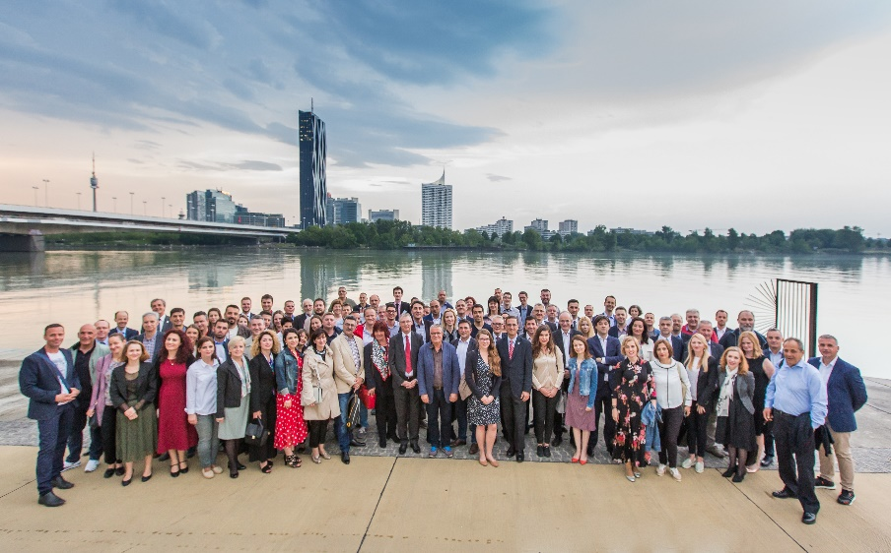
Danube water conference
We go biannual!
Even years: Danube Water Forum in the region
Uneven years: Danube Water Conference in Vienna
Next DWC: 2021

Slide 8
What is resilience?
Depending on the discipline, the definition varies:
  Ecological: the capacity of an ecosystem to recover from perturbations
  Psychological: an individual's ability to adapt in the face of adverse conditions
  Engineering: the ability of buildings and infrastructure to absorb assaults without suffering complete failure
  Institutional: the ability of a system to withstand changes in its environment and still function

Slide 9
Words of Welcome
Ms. Elisabeth Gruber, Director for International Financial Institutions, Austrian Federal Ministry of Finance
Mr. Walter Kling, President, IAWD
Ms. Linda van Gelder, Country Director for the Western Balkans, World Bank
Notes:
Phil

Slide 10
Lessons learned
Requests/Suggestions | Solution
Eliminate parallel sessions | One track session
More practical demonstration of projects, best practices and innovation | Increased number of case studies to be presented
Less and shorter presentations, allow more discussion | Less and shorter presentations, strong involvement of audience via pollev.com
More inclusive to Young Water Professionals | Chair/Co-chair system YWP on panel YWP to rapporteur YWP workshop in cooperation with IWA

Slide 11

Housekeeping
Group photo will be taken at 12:45 prior to lunch
Business reception and Conference Dinner (Campusbräu) at 18:30
Questions on logistics?
  World Bank: Elvira Broeks
  IAWD: Katerina Schilling, Katherine Wagner
Program page 36
Notes:
David

Slide 12
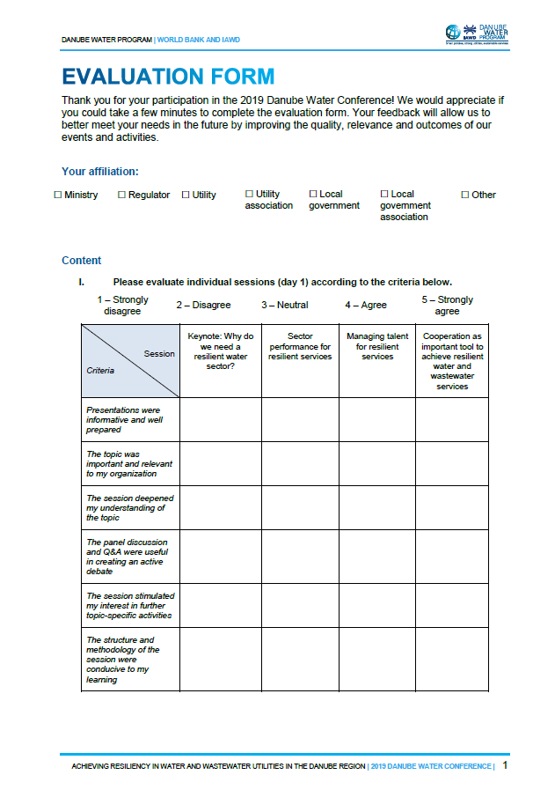
Evaluation forms
In your conference bag
Please help us getting better:
  Fill it out as you go
  Leave the completed form at the registration desk!
  THANK YOU!
Notes:
Phil

Slide 13
Ensuring a successful conference
WHAT? | HOW?
Actively participate | Open Dialogue and active involvement
Time management | Be on time, stick to time allocations
Productive use of session time | Please keep questions and responses brief and to the point in the sessions
Taking discussions further & deeper | Use the breaks
Network | Coffee Breaks, Lunch, Business Reception, Conference Dinner

Slide 14

Participate!
Connect to Internet
  Network Name: besucher
  No User or PW required
  Please accept Terms and Conditions
Pollev.com/2019dwc745
on your tablet, smartphone or laptop
Questions will change through the conference
Let’s try it!
Notes:
David

Slide 15
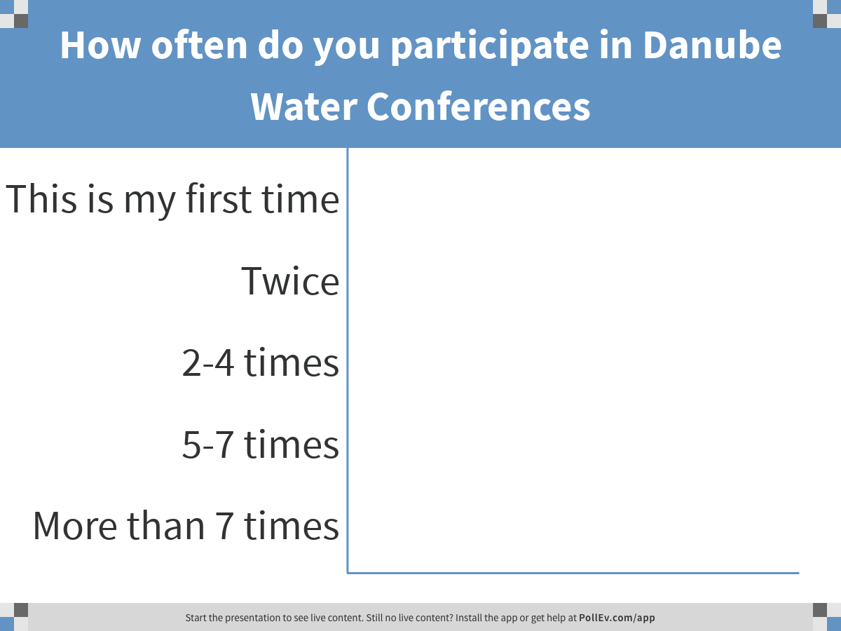
Notes:
Poll Title: How often do you participate in Danube Water Conferences
https://www.polleverywhere.com/multiple_choice_polls/Fpl362UWXSRp5EYxY47we

Slide 16
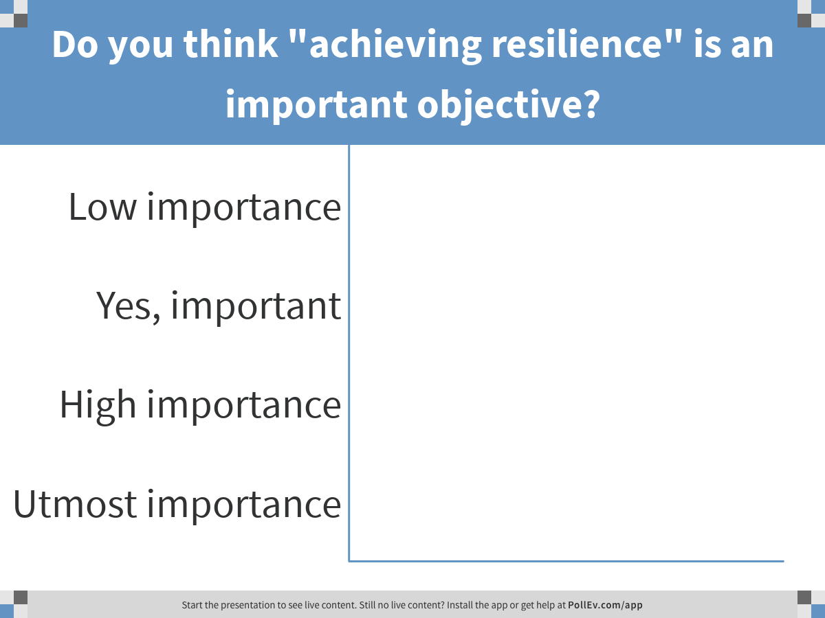
Notes:
Poll Title: Do you think "achieving resilience" is an important objective?
https://www.polleverywhere.com/multiple_choice_polls/11ON1JSUwA5lLFQT4QRwN

Slide 17
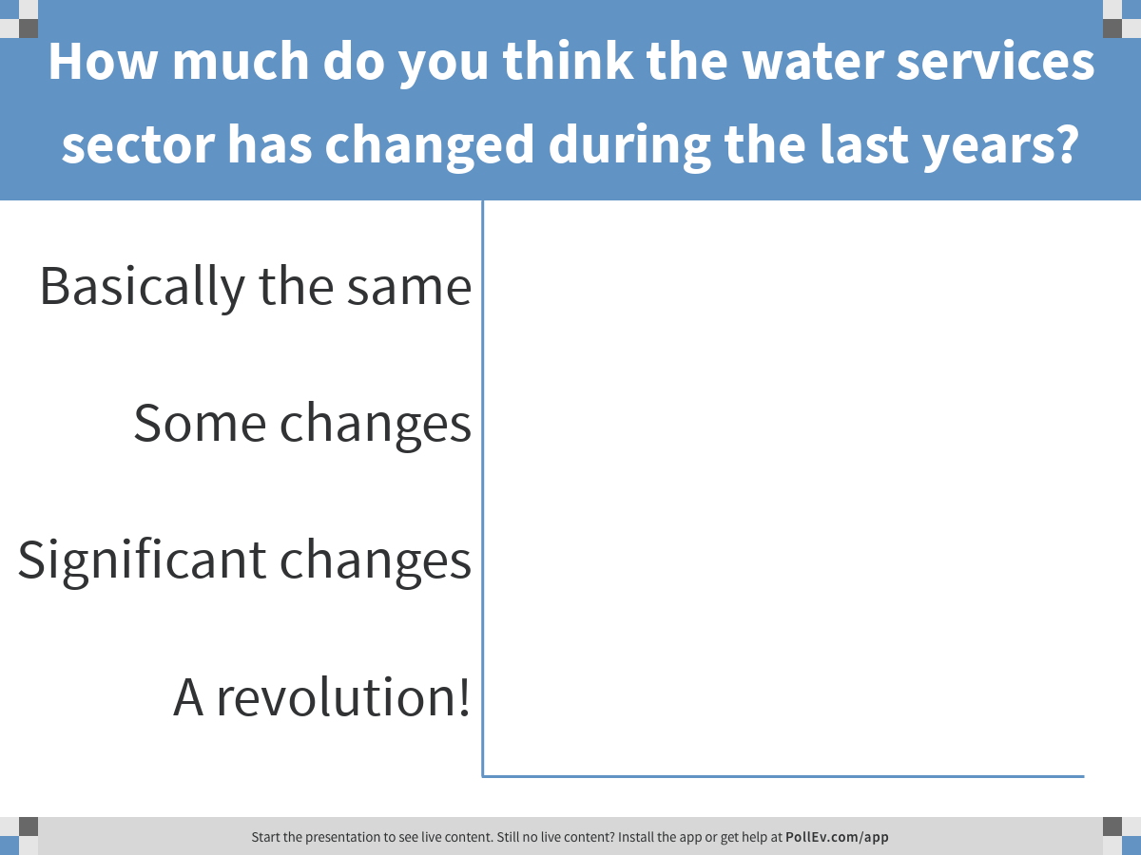
Notes:
Poll Title: How much do you think the water services sector has changed during the last years?
https://www.polleverywhere.com/multiple_choice_polls/WNHfwVD2bqW7BzvytTiSm

Slide 18
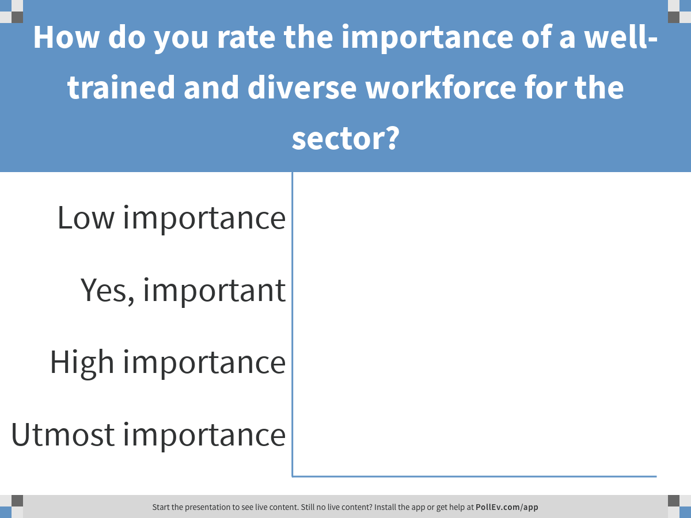
Notes:
Poll Title: How do you rate the importance of a well-trained and diverse workforce for the sector?
https://www.polleverywhere.com/multiple_choice_polls/VhWJZG6KfnlOy1ErOVkOC

Slide 19
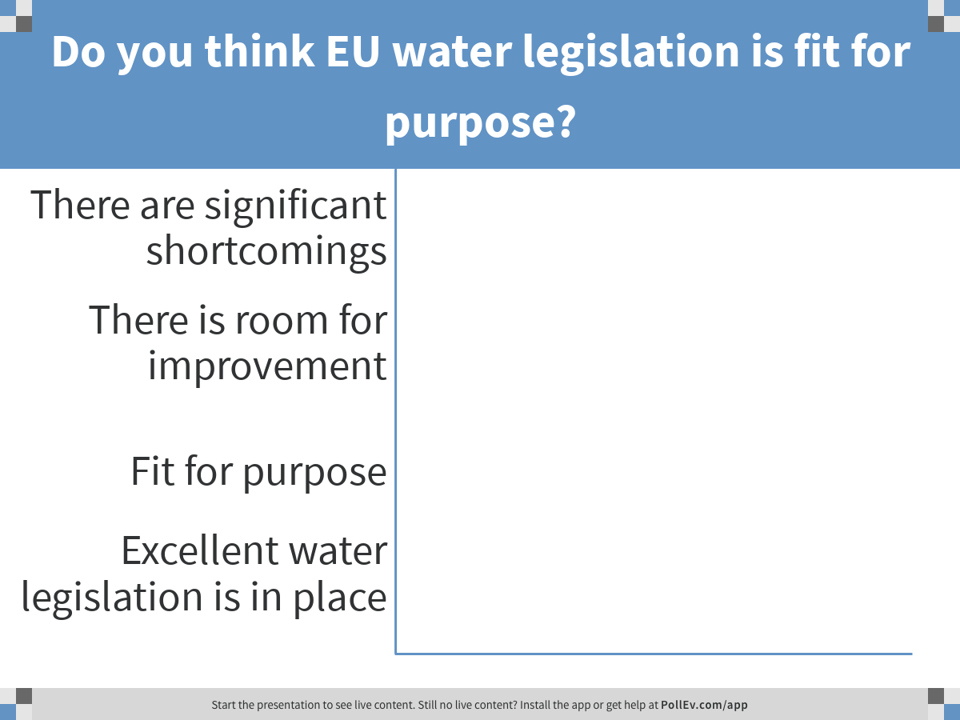
Notes:
Poll Title: Do you think EU water legislation is fit for purpose?
https://www.polleverywhere.com/multiple_choice_polls/QxVrHgc4qQnxRVL5UPZgy

Slide 20
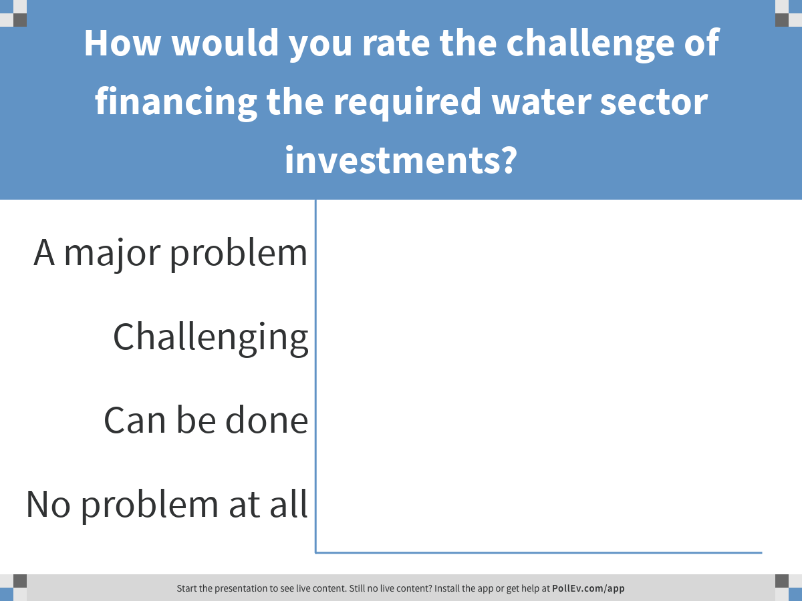
Notes:
Poll Title: How would you rate the challenge of financing the required water sector investments?
https://www.polleverywhere.com/multiple_choice_polls/VToK1I3QWY86q01zcmG3w

Slide 21
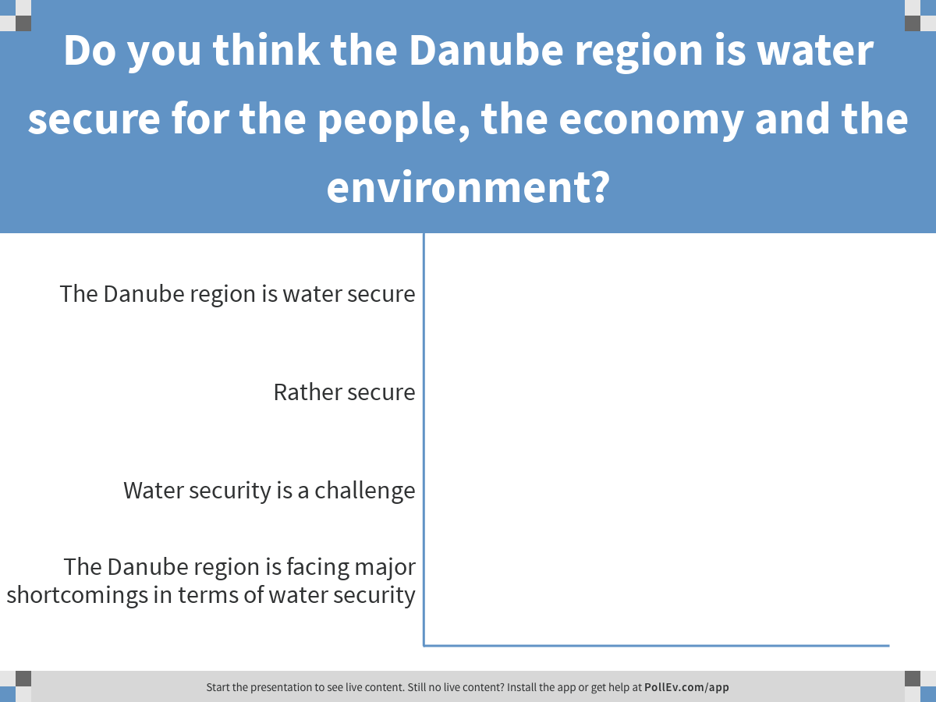
Notes:
Poll Title: Do you think the Danube region is water secure for the people, the economy and the environment?
https://www.polleverywhere.com/multiple_choice_polls/gn27vx6BLwEFqEvxliEJB

Slide 22
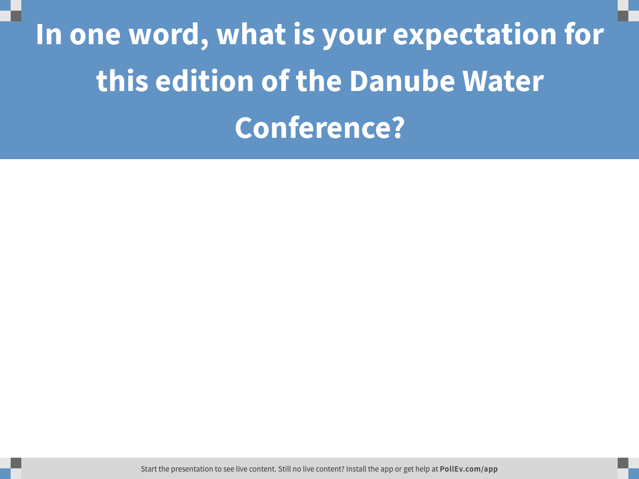
Notes:
Poll Title: In a few words, what is your expectation for this edition of the Danube Water Conference?
https://www.polleverywhere.com/free_text_polls/daAXtc9qGKK2P4NovgNwR

